Slide 1


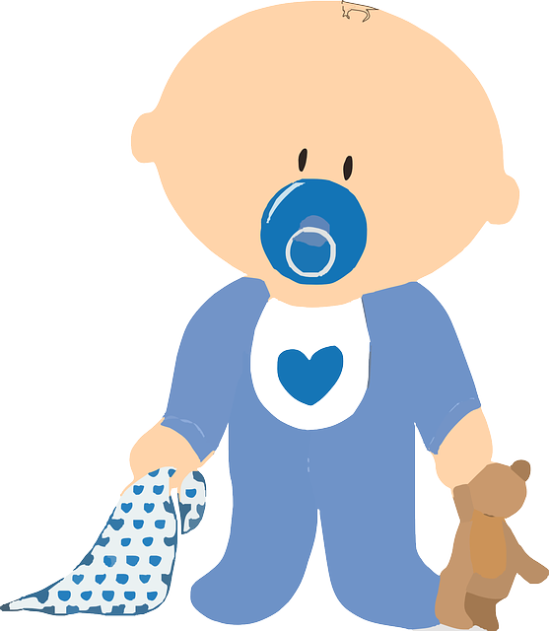





Advanced Epidemiological Triangle: Sepsis
Kari Bernhardt BSN, RN, CEN, DNP-S
Time
  Early detection of sepsis signs and symptoms
  Prompt medical care; “golden hour”
  Rapid initiation of interventions and reassessment
Annually, 1.7 million adults in America develop sepsis
Environmental Factors
      Limited access to healthcare
      Lower socioeconomic status
      Unsanitary living conditions
      Antibiotic Resistance and development of ‘superbugs’ from use in agriculture and inappropriate antibiotic use
      Treatment in a hospital setting, ICU, long-term care facility
      Having an invasive device (ex: catheter)
      Ignoring the s/s of infection
(CDC, 2020)
3-hour bundle
  Obtain blood cultures
  administer broad-spectrum antibiotics
  rapid admiration of crystalloids
  measure lactate level
(CDC, 2020)
270,000 Americans die as result of sepsis
(Sepsis Alliance, 2020)
6-hour bundle
  apply vasopressor to maintain a MAP>65
  re-assess volume status and tissue perfusion
  Re-measure lactate
Number 1 cost of hospitalization ins the U.S.
Estimated $62 billion annually
Costs double the average stay for al other conditions
1 in 3 patients who dies in a hospital has sepsis
(Jozwiak et al., 2016)
(Sepsis Alliance, 2020)
Causative Factors
Respiratory tract
(CDC, 2020)
77.6%
Population at Highest Risk
      Anyone with an infection can develop sepsis but some are more at risk than
      Pregnant women Neonates The elderly
      Hospitalized Chronic Immunosuppressed
      Diseases
Genitourinary
28.3%
Gram-Positive
  Staphylococcus Aureus
  MRSA
  S.Pneumoniae
Abdominal
16.7%
Most sepsis is caused by bacterial infections or complication of a viral infection like COVID-19 or influenza
Would/Soft tissue
16.5
Common Sites of Infection
Gram-Negative
  Pseudomonas Species
  Escherichia coli
  Klebsiella species
Unspecified
15.3%
Device-related
2.2%
Other Organisms
  Fungi (Candida)
  Parasites
  Anaerobes
  Other
Endocarditis
1.4%
Central Nervous System
1.2%
(Mayr et al., 2013)
(World Health Organization, 2020)
(Mayr et al., 2013)
(National Institute of General Medical Sciences, 2020)

Slide 2
References
Centers for Disease Control and Prevention. (2020, December 7). Clinical resources. https://www.cdc.gov/sepsis/clinicaltools/index.html
Jozwiak, M., Monnet, X., & Teboul, J.-L. (2016). Implementing sepsis bundles. Annals of Translational Medicine, 4(17), 332–332. https://doi.org/10.21037/atm.2016.08.60
Mayr, F. B., Yende, S., & Angus, D. C. (2013). Epidemiology of severe sepsis. Virulence, 5(1), 4–11. https://doi.org/10.4161/viru.27372
National Institute of General Medical Sciences. (2020, September 10). Sepsis. https://www.nigms.nih.gov/education/fact-sheets/Pages/sepsis.aspx
Sepsis Alliance. (2020a, August 9). Antimicrobial resistance (amr)/antibiotic resistance. https://www.sepsis.org/sepsisand/antibiotic-resistance/
World Health Organization. (2020, August 26). Detail. Sepsis. https://www.who.int/news-room/fact-sheets/detail/sepsis

